Slide 1


VARASUN TECHNOLOGIES
Transforming Technology
Into Business Advantage
Enterprise technology transformation — AI & Data, Cloud & Infrastructure,
Cybersecurity, Digital Workplace and Managed Services.
RISING WITH INNOVATION. LEADING WITH TECHNOLOGY.
Notes:
Open with the brand promise: Varasun turns technology into business advantage. Set the tone — we are a transformation partner, not an IT vendor. Mention the dual-shore model (USA + India) in one sentence and move on.

Slide 2

WHO WE ARE
One partner from strategy
to 24/7 operations
Varasun unites enterprise advisory, engineering, cybersecurity and managed operations
under one accountable team.
US-based strategy and program leadership.
India Global Delivery Center for engineering and operations scale.
Notes:
Key point: one accountable partner from strategy to 24/7 operations. Emphasize that the team that designs the solution also operates it — no handoff gap. US advisory + India engineering scale.

Slide 3

01 — AI & Data Solutions
▸ AI strategy & roadmaps
▸ Generative AI, RAG & agentic systems
▸ Data platforms, pipelines & analytics
▸ AI governance & security
▸ Managed AI operations
VARASUN TECHNOLOGIES
Notes:
Lead with the problem: most enterprise AI never leaves the lab. Position our path — data readiness, production engineering, governance — as the differentiator. Land the outcome-based message: we commit to metrics, not demos.

Slide 4
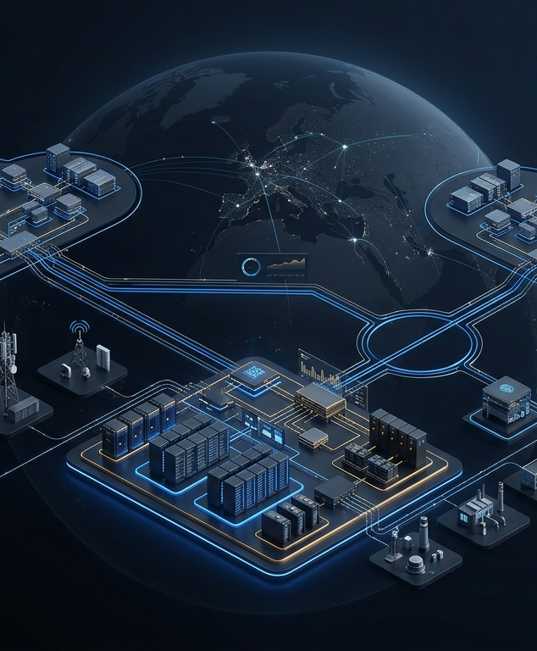
02 — Cloud & Infrastructure
▸ Cloud strategy, migration & modernization
▸ Hybrid & multi-cloud architecture
▸ Cloud-native & Kubernetes platforms
▸ FinOps & cost governance
▸ Disaster recovery & business continuity
VARASUN TECHNOLOGIES
Notes:
Lead with cost and complexity pain (hybrid sprawl, unpredictable bills). Position cloud as an operating capability, not a migration project. Highlight FinOps and AI-ready infrastructure — both are top 2026 buyer concerns.

Slide 5
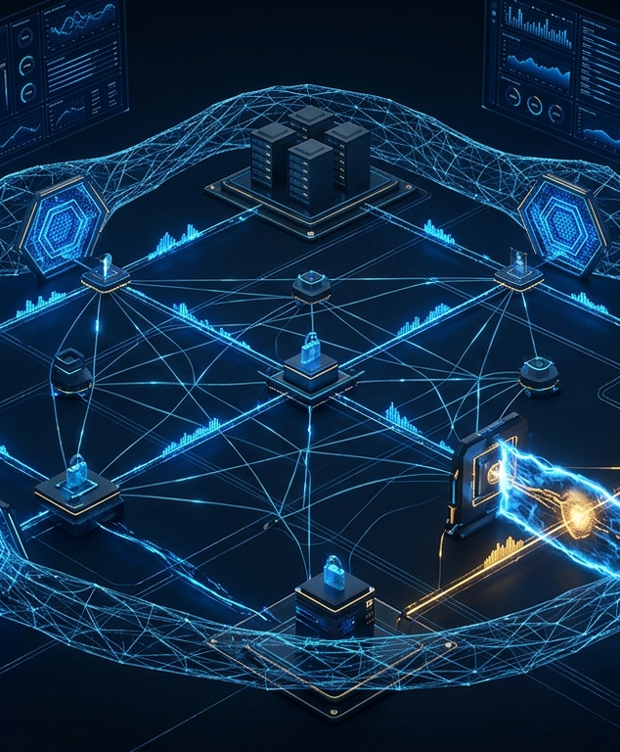
03 — Cybersecurity
▸ Security strategy & zero trust
▸ Identity & access architecture
▸ 24/7 SOC — detection & response
▸ Cloud & AI security
▸ Compliance & audit readiness
VARASUN TECHNOLOGIES
Notes:
Lead with the expanding attack surface (multicloud, SaaS, AI agents). Differentiate: preemptive security and a 24/7 SOC, not resold tools. If the buyer has a CISO, spend extra time on the zero-trust blueprint approach.

Slide 6

04 — Digital Workplace
▸ Microsoft 365 & collaboration
▸ Endpoint management & security
▸ Identity-first secure access
▸ Employee experience analytics
▸ Managed workplace operations
VARASUN TECHNOLOGIES
Notes:
Connect to hybrid-work pain and client security questionnaires. Microsoft 365 optimization is the easy entry point — most clients use 20% of what they pay for. Position security and productivity as one project.

Slide 7

05 — Managed IT Services
▸ MSP — infrastructure & IT operations
▸ MSSP — managed security operations
▸ NOC & SOC — 24/7 monitoring
▸ Service desk & ITSM
▸ Automation & observability
VARASUN TECHNOLOGIES
Notes:
The commercial centerpiece. Walk the MSP/MSSP/NOC/SOC distinction slowly — buyers often conflate them. Emphasize automation-first operations and outcome-based SLAs: fewer incidents over time, not just ticket handling.

Slide 8

06 — Technology Consulting
▸ IT & digital strategy
▸ Technology assessment & architecture
▸ Transformation roadmaps
▸ Cloud & AI strategy
▸ Governance & operating models
VARASUN TECHNOLOGIES
Notes:
Position as the strategic layer that connects everything else. Key line: 'strategy that can actually be implemented' — our advisors stay through delivery. Best entry point for new enterprise relationships.

Slide 9

INDUSTRIES
Deep context in the sectors we serve
Healthcare & Life Sciences
Financial Services
Manufacturing
Government
Retail & Consumer
Professional Services
Technology
Education
Notes:
Pick the 1–2 industries matching the prospect and go deep — the industry landing pages on the website carry the detail. Message: we speak your industry's language, not generic IT.

Slide 10

HOW WE WORK
The Varasun transformation framework
01
02
03
04
05
06
Discover
Strategize
Design
Implement
Optimize
Operate
From first diagnostic to continuously operated environments — six chapters, one accountable partner.
Notes:
Walk the six chapters left to right. Emphasize Operate — most competitors stop at Implement. This is where the managed-services conversation naturally begins.

Slide 11
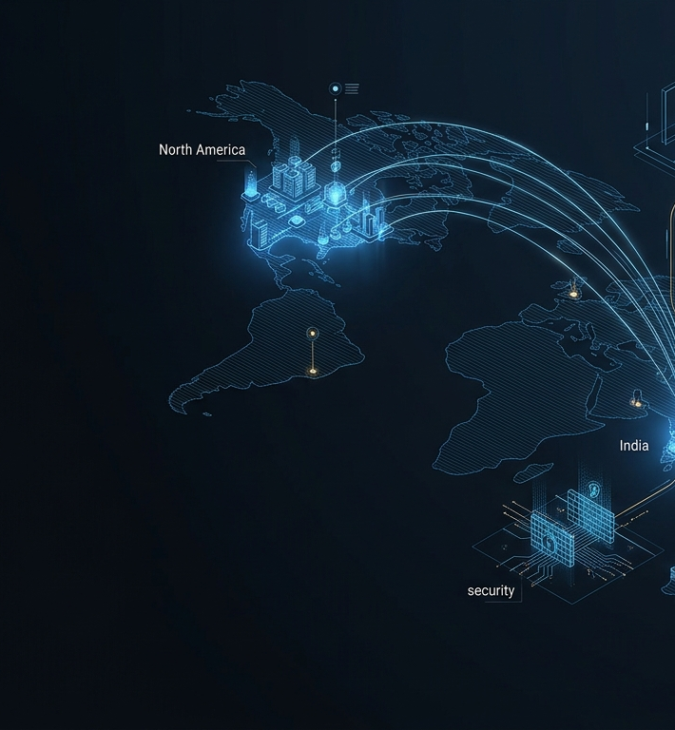
GLOBAL DELIVERY
USA strategy.
India engineering scale.
Varasun Technologies LLC — United States
Enterprise advisory & program leadership
Varasun Technologies India Pvt Ltd — India
Engineering, cloud operations & managed services
Notes:
Address the offshore question head-on: US-led strategy and client accountability, India-based engineering scale. One team, one standard — follow-the-sun operations capability.

Slide 12
Ready to transform what's possible?
Let's discuss your technology priorities and build a practical path forward.
varasuntechnologies@gmail.com
VARASUN TECHNOLOGIES — RISING WITH INNOVATION. LEADING WITH TECHNOLOGY.
Notes:
Ask for the next step directly: a 30-minute discovery call or a scoped assessment. Leave this slide up during Q&A — the contact email stays visible.

